Slide 1
Designing Database Solutions for SQL Server
Christian Bolton | Technical Director, Coeo
Graeme Malcolm | Microsoft

Slide 2
Course Topics
Designing Database Solutions for SQL Server
01 | Managing a SQL Server Environment
02 | Designing Database Security
03 | Designing a Backup & Recovery Solution
04 | Designing a High-Availability Solution
05 | Troubleshooting & Maintaining a database

Slide 3
05 | Troubleshooting & Maintaining a Database
Christian Bolton | Technical Director, Coeo
Graeme Malcolm | Microsoft

Slide 4
Module Overview
Key Maintenance Tasks
Tools and Techniques for Monitoring
Investigating Problems

Slide 5
Key Maintenance Tasks
Ensuring Database Integrity
Maintaining Indexes
Automating Database Maintenance

Slide 6
Ensuring Database Integrity
Physical Integrity
Data pages are written top physical storage as SQL Server requested and can be read correctly
Logical Integrity
Data within pages is logically correct

Slide 7
Ensuring Database Integrity
DBCC CHECKDB
Checks logical and physical integrity in the database
Offers some repair options
Runs online using a internal database snapshot
Synchronize executions with your backup strategy

Slide 8
Ensuring Database Integrity
Option | Description
PHYSICAL_ONLY | Only checks the physical integrity to reduce overhead
NOINDEX | Does not perform logical checks on nonclustered indexes
EXTENDED_LOGICAL_CHECKS | Performs additional logical checks of indexed views, spatial, and XML indexes
TABLOCK | Uses locks instead of database snapshots
ALL_ERRORMSGS | Returns all error messages instead of the default action that returns the first 200
NO_INFOMSGS | Returns only error messages and no informational messages
ESTIMATEONLY | Estimates the amount of tempdb space that it requires to run

Slide 9
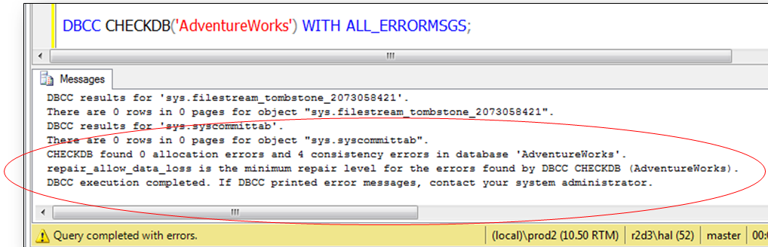
Ensuring Database Integrity
DBCC CHECKDB Repair Options
Database needs to be in SINGLE_USER mode
REPAIR_REBUILD
REPAIR_ALLOW_DATA_LOSS
Consider restoring a database instead of allowing data loss

Slide 10
Running CHECKDB

Slide 11
Index Fragmentation
Fragmentation occurs when data changes cause index pages to split
Internal fragmentation when pages are not full
External fragmentation when pages are not in logical sequence
Detecting fragmentation
Index properties in SQL Server Management Studio
sys.dm_db_index_physical_stats

Slide 12
FILLFACTOR and PAD_INDEX
ALTER TABLE Person.Contact
ADD CONSTRAINT PK_Contact_ContactID
PRIMARY KEY CLUSTERED
(
ContactID ASC
) WITH (PAD_INDEX = ON, FILLFACTOR = 70);
GO
FILLFACTOR leaves space in index leaf-level pages for new data to avoid page splits
PAD_INDEX uses the value specified in FILLFACTOR for the intermediate pages of the index

Slide 13
Removing Fragmentation
REBUILD
Rebuilds the whole index
Needs free space in the database
Performed as a single transaction
Beware of log space requirements
REORGANIZE
Sorts the pages and is always online
Less transaction log usage
Work isn’t lost if interrupted
ALTER INDEX IX_Contact_LastName
ON Person.Contact
REBUILD;
ALTER INDEX IX_Contact_City
ON Person.Contact
REORGANIZE;

Slide 14
Online Index Operations
ALTER INDEX IX_Contact_EmailAddress
ON Person.Contact
REBUILD
WITH (ONLINE = ON, MAXDOP = 4 );
Enterprise Edition of SQL Server can rebuild indexes online
Enables concurrent user access
Slower than the equivalent offline operation
Effectively creates a new index in parallel with the old so space in the data file is a consideration
Lots of updates during the rebuild will use tempdb heavily

Slide 15
Updating Statistics
As data changes, statistics become outdated
Updated automatically or on demand
AUTO_UPDATE_STATISTICS
Database option on by default
UPDATE STATISTICS
Manually trigger an update for a table or specific statistics
sp_updatestats
Updates all statistics in a database
ALTER INDEX REBUILD
Also rebuilds the statistics with FULLSCAN

Slide 16
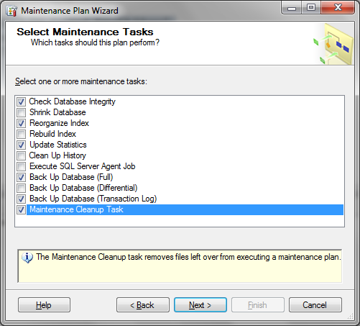
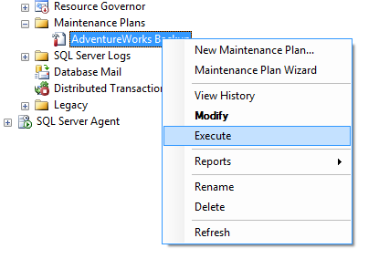
Automating Database Maintenance
SQL Server Maintenance Plans
Help you to schedule core maintenance tasks
Uses SSIS to perform tasks

Slide 17
SQL Server Maintenance Plans

Slide 18
Tools and Techniques for Monitoring
Activity Monitor
Dynamic Management Views and Functions
Performance Monitor
SQL Server Profiler
SQL Trace

Slide 19
Tools and Techniques for Monitoring
Database Engine Tuning Advisor
Distributed Replay
SQL Server Data Collection
SQL Server Utility Control Point
Microsoft System Center Operations Manager

Slide 20
Troubleshooting and Maintaining a Database
Summary
Key Maintenance Tasks
Tools and Techniques for Monitoring
Investigating Problems

Slide 21
Designing Database Solutions for SQL Server
Managing a SQL Server Environment
Designing Database Security
Designing a Backup & Recovery Solution
Designing a High-Availability Solution
Troubleshooting & Maintaining a database

